Slide 1

MIS 547
CLOUD COMPUTING

Slide 2
Admin
Exam 2 is November 7 (Thursday)
03
November 5th is Exam 2 Review
04
Quiz 9 Opens Thursday @ 5pm
02
Mid-semester updates due Thursday October 31!!
01
If you need the time off from class to vote, please DM me!!

Slide 3
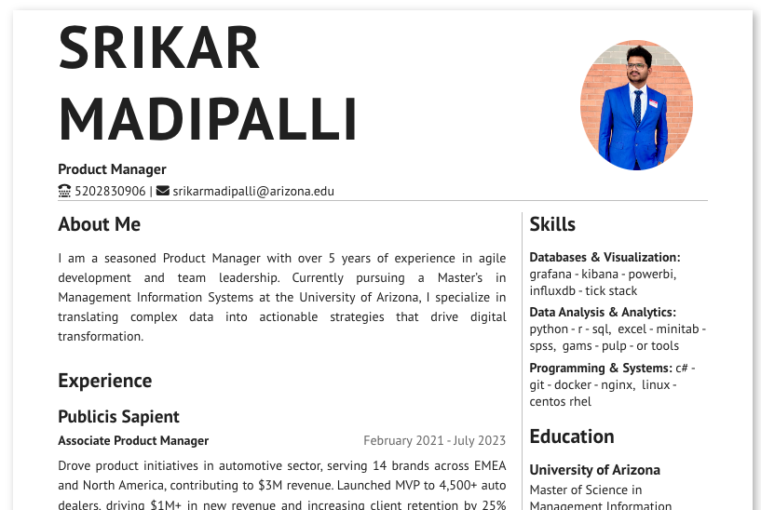
Assignment 6 Feedback
Cool things people did:
Headers as links to external resources
Great looking avatars
Removing the second page if you don’t need the room

Slide 4
Other Ideas for Assignment 6
Create a throw-away email address just for recruiters
Use Google Voice or TextNow to create a phone number that recruiters and hiring managers can use
Include a link to your GitHub somewhere on your site!
Notes:
Check in about code walkthrough

Slide 5
LECTURE 18: CLOUD SECURITY DAY 1

Slide 6
CLOUD THREATS
WHAT ARE WE SECURING OUR CLOUD APPLICATION FROM?

Slide 7

TOP CLOUD SECURITY ISSUES
Data Breaches
Misconfiguration and Inadequate Change Control
Lack of Cloud Security Architecture and Strategy
Insufficient Identity, Credential, Access and Key Management
Account Hijacking
Insider Threat
Insecure Interfaces and APIs
Weak Control Plane
Metastructure and Applistructure Failures
Limited Cloud Usage Visibility
Abuse and Nefarious Use of Cloud Services
Source: Cloud Security Alliance, 2019

Slide 8
TOP CLOUD SECURITY ISSUES
Data Breaches
Misconfiguration and Inadequate Change Control
Lack of Cloud Security Architecture and Strategy
Insufficient Identity, Credential, Access and Key Management
Account Hijacking
Insider Threat
Insecure Interfaces and APIs
Weak Control Plane
Metastructure and Applistructure Failures
Limited Cloud Usage Visibility
Abuse and Nefarious Use of Cloud Services
Source: Cloud Security Alliance, 2019

Slide 9
DATA BREACH
An incident where sensitive, protected, or confidential information is released, viewed, stolen, or used by an unauthorized individual.
Data is one of, if not the main, target of cyber attacks. Data breaches have been ranked the number one cloud threat by the Cloud Security Alliance.

Slide 10
DATA BREACH: CAPITAL ONE
Web application compromised; IAM credentials gained
How
106M customer accounts exfiltrated, data included credit card customer status reports, names, addresses, zip codes, date of birth, income, credit scores, credit limits, social security numbers
What
6.9% stock price drop, regulatory fines, $80M settlement for credit monitoring
Impact

Slide 11
ACCOUNT HIJACKING
A threat in which malicious attackers gain access to and abuse accounts that are highly privileged or sensitive. The accounts with the highest risk are service accounts or subscription accounts.
Access is gained through phishing attacks, exploitation of cloud systems, or stolen credentials.
Account hijacking implies full compromise: control of the account, services, and data.

Slide 12
ACCOUNT HIJACKING: TESLA
External actors gained access to unsecured K8 admin interface, and through K8, gained further access to AWS S3 buckets containing non-public vehicle telemetry data.
How
Attackers gained access to proprietary intellectual property, installed cryptocurrency mining scripts on core Tesla infrastructure
What
Increase in cloud computing costs, risk of selling IP to competitor
Impact

Slide 13
INSIDER THREAT
The potential for an individual who has or had authorized access to an organization’s assets to use their access, either maliciously or unintentionally, to act in a way that could negatively affect the organization.
Actors could be current or former employees, contractors, or other trusted business partners.

Slide 14
INSIDER THREAT: DOW JONES
3rd party vendor failed to password protect or encrypt AWS-hosted Elasticsearch database
How
2.4M records detailing politically exposed persons
What
Revenue loss due to litigation, sensitive data leakage
Impact

Slide 15
OTHER INSIDER THREATS
Tesla, 2018: disgruntled employee used false usernames to make changes to the code used in the Tesla Manufacturing Operating System and exported large amounts of highly sensitive data to third parties.
Punjab National Bank, 2018: an employee used unauthorized access in the SWIFT interbank transaction system to release funds to a diamond merchant to buy rough stones from suppliers.
IBM X-Force Threat Intelligence, 2018: Misconfigured systems were responsible for the exposure of more than 2 billion records.

Slide 16
ABUSE AND NEFARIOUS USE OF CLOUD SERVICES
Malicious actors leverage cloud computing resources to target users, organizations, or other cloud providers. Types of misuse include:
Hosting malware
Launching DDoS attacks
Spam and phishing campaigns
Cryptocurrency mining
Automated click fraud
Brute-force attacks of stolen credential databases
Hosting malicious or pirated content

Slide 17
ABUSE AND NEFARIOUS USE OF CLOUD SERVICES: RING
Third-party trackers on Ring doorbells sent PII to four Analytics and Marketing companies without users informed consent.
How
Data breach of consumer PII via third-party trackers, misconfiguration stemming from the absence of functionality that seeks user consent
What
Regulatory fines, class action lawsuits, negative publicity, erosion of consumer trust
Impact

Slide 18
THREAT ACTORS
THE PERSONAS BEHIND CLOUD ATTACKS

Slide 19
THREAT ACTORS: ATTACKER PERSONAS
Organized crime or independent actors
Hactivists
Insider Actors
State Actors
Motivation: usually financial
Motivation: Discrediting an org by releasing stolen data, committing vandalism, disrupting business
Motivation: Discrediting an org or making money
Can also have non-nefarious motivation/intent
Motivation: Stealing secrets, disrupting business to advance a foreign gov’s political mission or cause

Slide 20
SECURITY PRINCIPLES

Slide 21
DEFENSE IN DEPTH
Plan for failure
Overlapping Controls
Practical application
Almost any security control can fail, either because attacker is sufficiently determined and skilled, or because of a problem with the way the control is implemented.
Defense in depth means creating multiple layers of overlapping security controls
Indentify any security control and ask “what if this fails?”

Slide 22
LEAST PRIVILEGE
Plan for unauthorized access
Practical application
People or automated tools should be able to access only what they need to do their jobs and no more.
Access policies are deny by default

Slide 23
ZERO TRUST
Assume your environment is compromised
Plan for unauthorized access
Practical application
Trust from a user or another system is earned, rather than given because the user is able to reach you on the network, has a company-owned device, etc.
Trust comes from evidence of strong authentication, authorization, or correct configuration.
Require encryption and authentication for all connections, even ones that originate in trusted networks.
Multifactor Authentication
Require periodic reauthentication

Slide 24

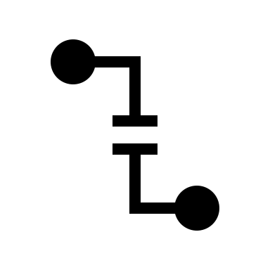
ATTACK SURFACE
THE SET OF ALL POSSIBLE WAYS A SYSTEM CAN BE ATTACKED.
THE MORE COMPLEX THE SYSTEM, THE BIGGER THE ATTACK SURFACE, AND THE MORE LIKELY IT IS THAT AN ATTACKER WILL FIND A WAY IN.

Slide 25
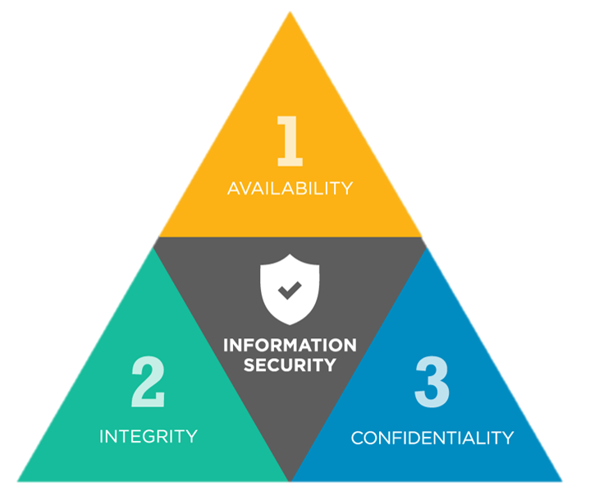
CIA TRIANGLE: SECURING DATA AND DATA SYSTEMS
Confidentiality
Integrity
Availability
Only authorized individuals/systems can view sensitive or classified information. Data being sent over the network should not be accessed by unauthorized individuals
Data is complete and accurate and an organization is able to protect it from corruption or tampering.
Network, systems, and data should be readily available to its users.

Slide 26
THE SHARED RESPONSIBILITY MODEL
Who is responsible for cloud security?

Slide 27
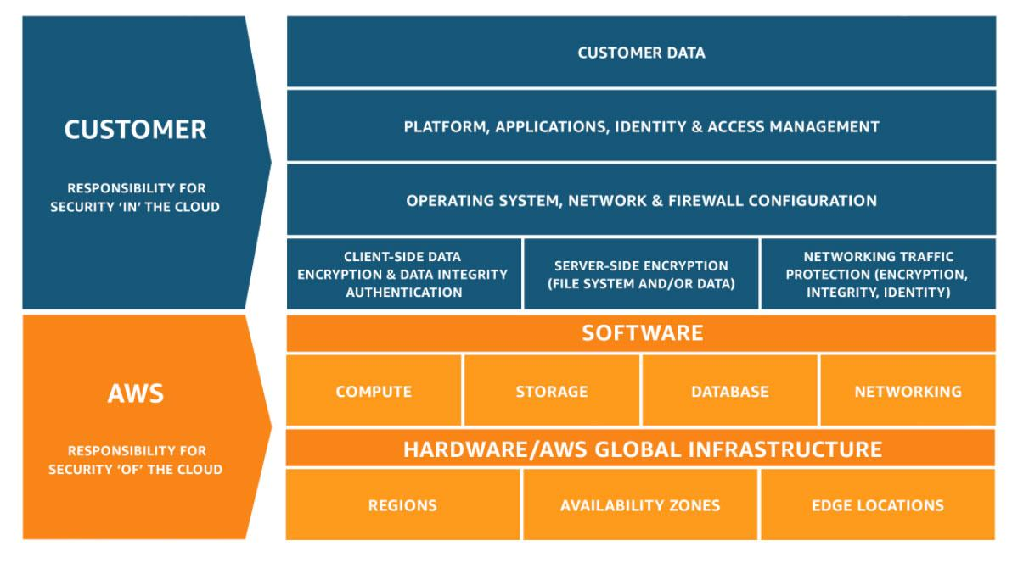
THE SHARED RESPONSIBILITY MODEL
CSP Responsibility: “Security of the Cloud”
Customer responsibility: “Security in the Cloud”
Source: https://aws.amazon.com/compliance/shared-responsibility-model/

Slide 28
CUSTOMER SECURITY RESPONSIBILITY
The customer responsibility will vary depending on the services they use:
IaaS (e.g. EC2)
Managed Services (e.g., S3, DynamoDB)
Guest OS updates and patching
Application software and utilities
Firewall configuration (security group)
Data
Classifying assets
IAM

Slide 29
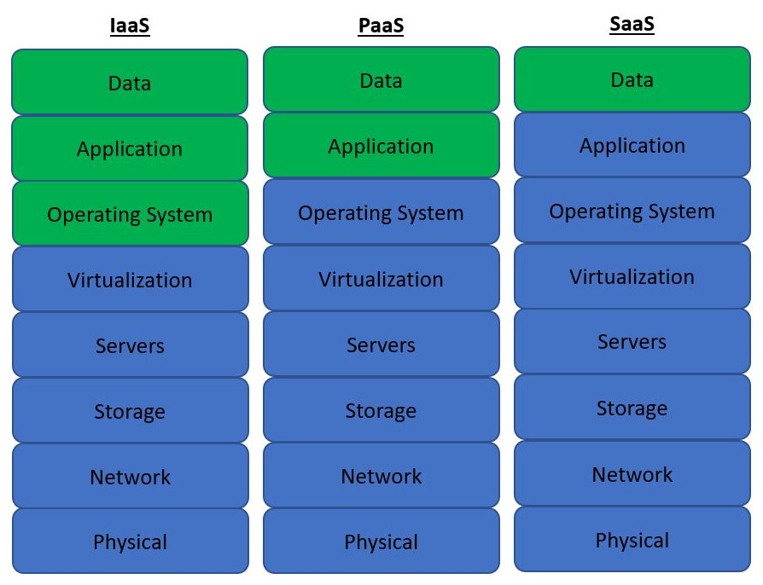
CUSTOMER SECURITY RESPONSIBILITY, CONT.
Source: Cloud Security Handbook

Slide 30
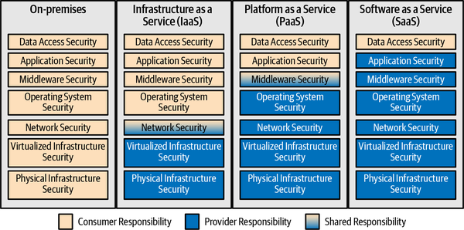
CUSTOMER SECURITY RESPONSIBILITY, CONT.
Source: Practical Cloud Security, 2nd Edition

Slide 31
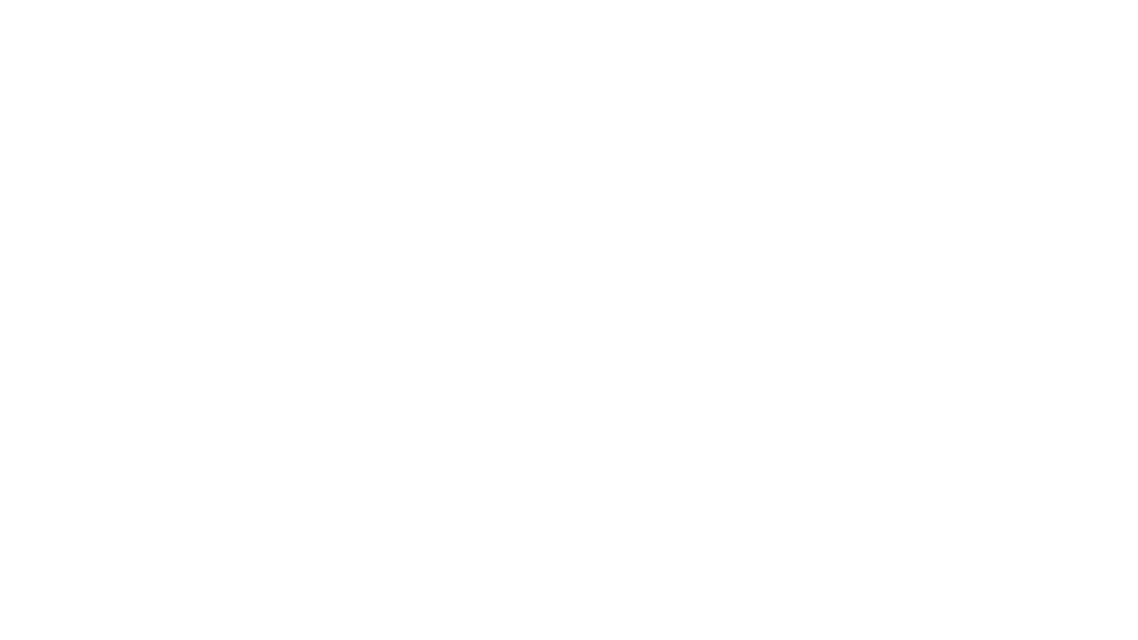
WHAT RESOURCES DO WE NEED TO SECURE IN THE CLOUD?

Slide 32
WHAT RESOURCES DO WE NEED TO SECURE IN THE CLOUD?
Infrastructure
Network
Applications
Software Supply Chain
Data
User and Service Accounts
Endpoints

Slide 33
WHERE SHOULD WE START?
Having a good mental model or framework for securing your cloud resources helps you determine what to prioritize (beyond the basics).
We need to think like a threat actor…

Slide 34
THREAT MODELING
CATASTROPHIZING FOR FUN AND PROFIT (AND SECURITY)

Slide 35
WHAT IS THREAT MODELING
Threat modeling is the practice of defining all threats that your business, application, system, or product will likely face.
Examples of questions we ask when threat modeling:
Will people try to intercept your data and sell it?
Would the data have any value?
What harm could come if that happened?
How can we protect against this?

Slide 36
THREAT MODELING
What was this thing designed to do?
What can it be made to do?
What can it be made to do (for evil)?

Slide 37
THREAT MODELING
If there is money...
If there is information in your system
If there are different levels of access within your app...
someone always wants to steal it.
there is always someone (who shouldn’t have access) that wants to see, change, or remove it.
someone will try to escalate their access.

Slide 38
THREAT MODELING
If you were going to attack your application, how would you do it?
What could go wrong?
How could the system be misused?
How can we ensure we protect the user (including from us?)
What is the worst-case scenario?

Slide 39
THREAT MODELING: WHERE TO START
Take user stories and turn them into abuse stories.
Several threat modeling methods
STRIDE
PASTA
Attack trees: goal of the attack, leaves are ways attacker could achieve the goal

Slide 40
STRIDE
 | Threat | Threat Definition
S | Spoofing Identity | Pretending to be something or someone other than yourself
T | Tampering with data | Modifying something on disk, memory, or elsewhere
R | Repudiation | Claiming that you didn’t do something or were not responsible; can be honest or false
I | Information disclosure | Providing information to someone not authorized to access it
D | Denial of service | Exhausting resources needed to provide service
E | Elevation of privilege | Allowing someone to do something they are not authorized to do
Source: OpenSSF Secure Software Development Fundamentals

Slide 41
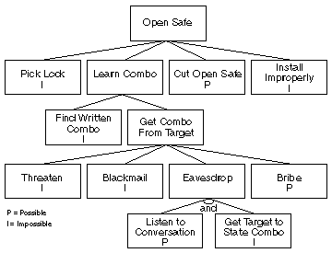
ATTACK TREES
Represent attacks against a system in a tree structure
The goal is the root node
Different ways of achieving that goal are leaf nodes
Each node becomes a subgoal and children of the node are ways to achieve that subgoal
Source: schneier.com

Slide 42
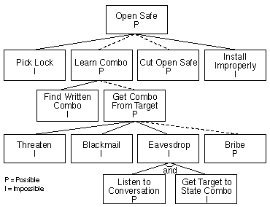
ATTACK TREES
AND and OR nodes
Possible and Impossible nodes
An OR node is possible if any of its children are possible; impossible if all of its children are impossible
An AND node is possible only if all of its children are possible
Source: schneier.com

Slide 43
THREAT MODELING
Can we have a completely secure system?
If the application is vulnerable, you must either change your application to mitigate the threat or accept the risk.
Risk acceptance must be in writing and signed off by management, C-level executives, and/or project stakeholders.

Slide 44
FRAMEWORKS: THINKING ABOUT THREATS AND MITIGATIONS

Slide 45
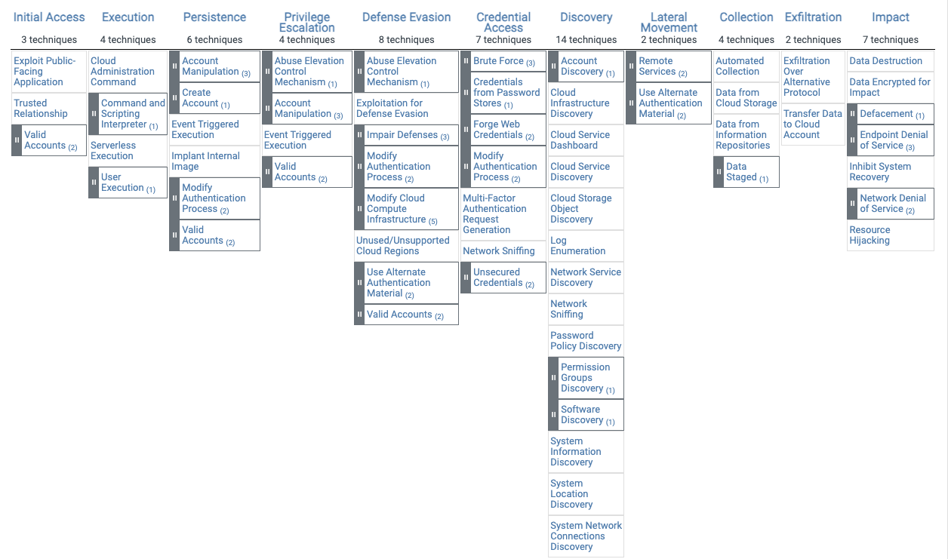
MITRE Cloud Matrix
Available: https://attack.mitre.org/matrices/enterprise/cloud/iaas

Slide 46
NIST Cybersecurity Framework (CSF)
5 NIST CSF Functions
Identify
Protect
Detect
Respond
Recover
Identify all people, processes, or systems that would be vulnerable to this threat
Limit the threat of an attack by removing or blocking the vulnerability
Detect the presence of a threat once it’s in the environment.
Prevent additional financial damage, reputation damage, non-compliance, or privacy violations
Return to a state that was equal or better than before the incident
Govern
Align cybersecurity activities with organizational objects
Policy & Oversight, Supply Chain Risk Management

Slide 47
Threat Modeling Your Application
STRIDE-LM | Functions and Safeguards
STRIDE-LM | Identify | Protect | Detect | Respond | Recover
Spoofing
Tampering
Repudiation
Information Disclosure
Denial of Service
Elevation of Privilege
Lateral Movement

Slide 48
THREAT MODELING: UNINTENDED USE OF YOUR APPLICATION

Slide 49
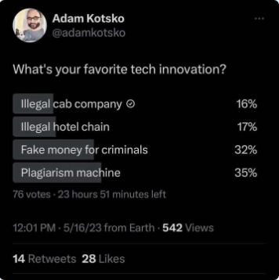
Threat Modeling: Unintended usage of your product
Social media
Disinformation and propaganda
Global instability
AI
Encoding bias into decision making
Deep fakes
Cryptocurrencies
Enabling global-scale crime markets
Environmental degradation
Short-term property rentals
Gentrification
Rent spikes

Slide 50
LAND ACKNOWLEDGEMENT STATEMENT
We respectfully acknowledge the University of Arizona is on the land and territories of Indigenous peoples. Today, Arizona is home to 22 federally-recognized tribes, with Tucson being home to the O’odham and the Yacqui. Committed to diversity and inclusion, the University strives to build sustainable relationships with sovereign Native Nations and Indigenous communities through education offerings, partnerships, and community service.

